Slide 1
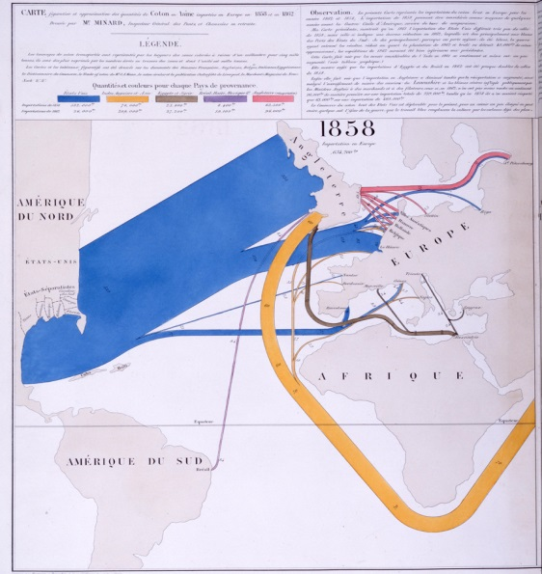
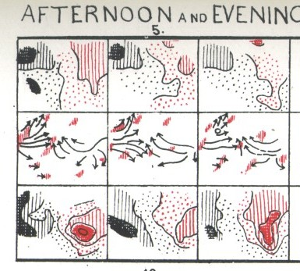
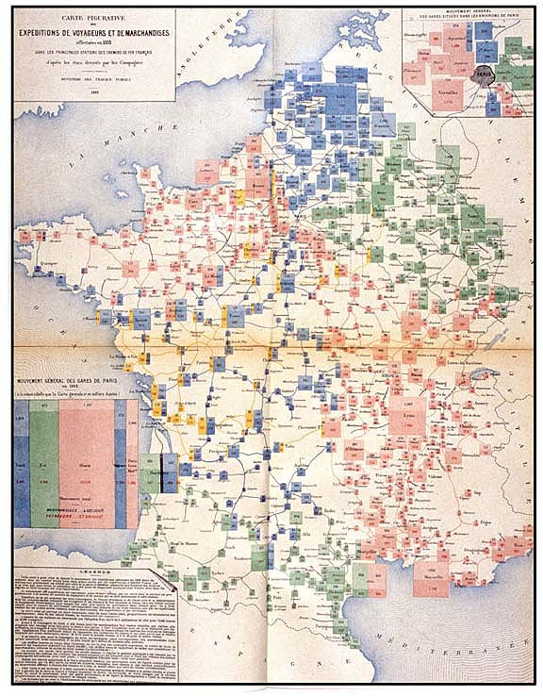

The Golden Age of Statistical Graphics
Michael Friendly
Psych 6135
https://friendly.github.io/6135

Slide 2
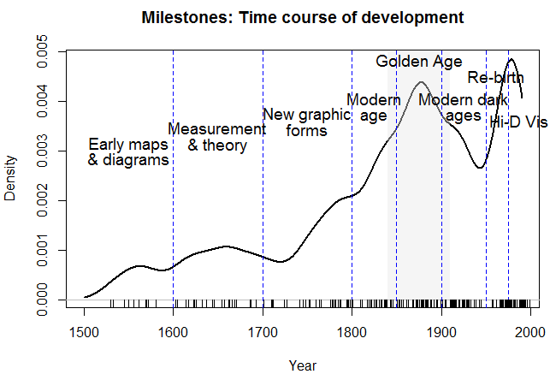
The Golden Age: ~ 1850 -- 1900
Why do I call this the “Golden Age of Statistical Graphics”?
The most obvious is as a peak in developments over the course of history.

Slide 3
What makes an “Age”? What makes one “Golden”?
Age:
Qualitatively distinct from before & after
Golden age:
Recognizable period in a field where great tasks were accomplished
Years following some innovations
Artists apply skills to new areas
New ideas expressed, art forms flourish
Often ends with some turning point event(s)
Notes:
Before proceeding it may be useful to clarify the idea of a Golden Age to see why the developments I will describe deserve to be recognized as such.
Age: period in history, not necessarily with sharp boundaries, but distinct from the periods before and after
Golden:

Slide 4
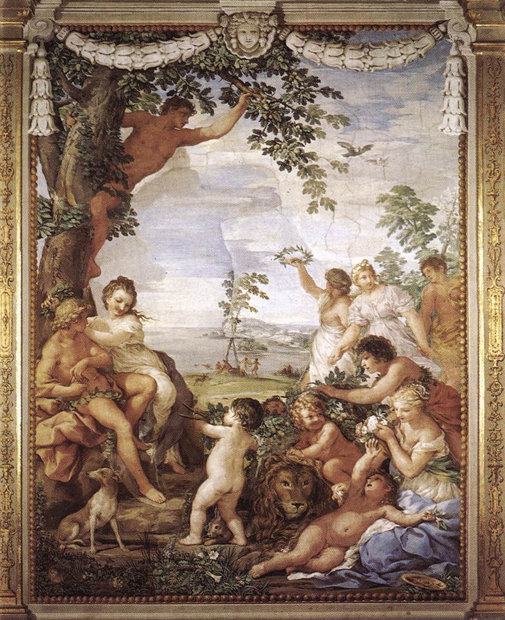
Some Golden Ages
Athens (Pericles): 448 BC—404 BC: growth & culture
Islam: 750—1258 (sack of Baghdad): science, math …
England: Elizabeth I (1558-1603): literature, poetry, …
Piracy: 1690--1730
Radio: 1920—1940
Animation: 1928 (sound) – 1960s (TV)
Senior citizens: 60+
Metaphors
Pietro Da Cortona, The Golden Age (Fresco, Sala della Stufa, Palazzo Pitti, Florence)
Notes:
Some examples:
The Golden Age of Athens under Pericles from the end of the Persian War to the start of the Peloponnesian Wars in 404 BC
Islam: Islamic caliphate (750) – Sack of Baghdad by the Mongols: arts, science, medicine, math
England: Elizabeth I– literature, poetry, theater
Metaphorical uses: Radio, animation, …

Slide 5
Preludes to the Golden Age
Infrastructure required:
Data: collection & dissemination
Statistical theory: combining & summarizing quantitative information
Technology: printing & reproduction of maps & diagrams
Visual language: new graphic forms for maps and diagrams
→ a perfect storm for data graphics
What does this imply for today?
Notes:
To appreciate how the period I call the Golden Age of Statistical Graphics arose, it is useful to understand the infrastructure required to produce this explosive growth in the last half of the 19th C. There are at least 4 areas deserving mention, but I will only mention and illustrate them briefly.

Slide 6
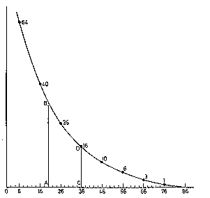
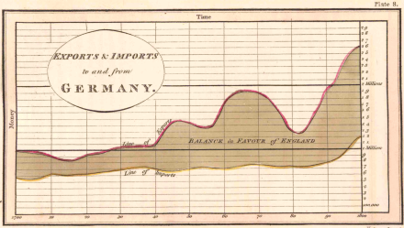
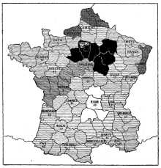
Preludes: data
“Data! Data! I can’t make bricks without clay.” – Sherlock Holmes, Copper Beeches
Population: ~ 1660--
Bills of mortality: Graunt (1662)
Political arithmetic: Petty (1665)
Demography: Süssmilch (1741)
Economic data: ~ 1770--
Revenue, expenditures, taxes
Imports, exports
Transport
Social data: ~ 1820--
Literacy, education
Crime, suicides, illegitimate births, prostitution
Poverty, debtors, disease
→ An avalanche of data, waiting to be visualized!
Notes:
Data graphics – maps & diagrams required, first, some useful & important data to display.
It would take me too far a field to describe this aspect in detail, so I will just list some of the main developments

Slide 7
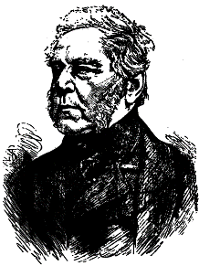
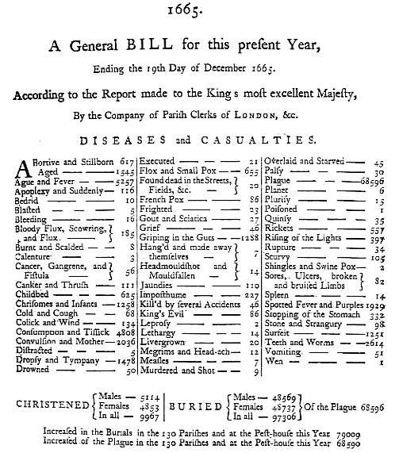
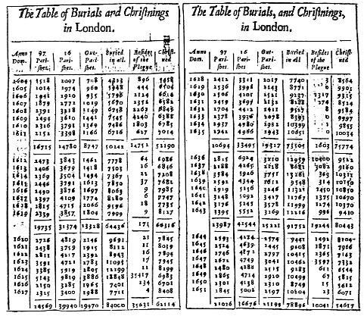
Population data: keeping track of births, deaths, causes of mortality
J. Graunt (1662) Natural and
Political Observations on the Bills of Mortality
Notes:
The ideas behind demography and epidemiology got started with John Graunt’s Bills of Mortality in 1862.
He tabulated all births and deaths in London, and, importantly, tried to classify all causes of death, highlighting those due to the plague.

Slide 8
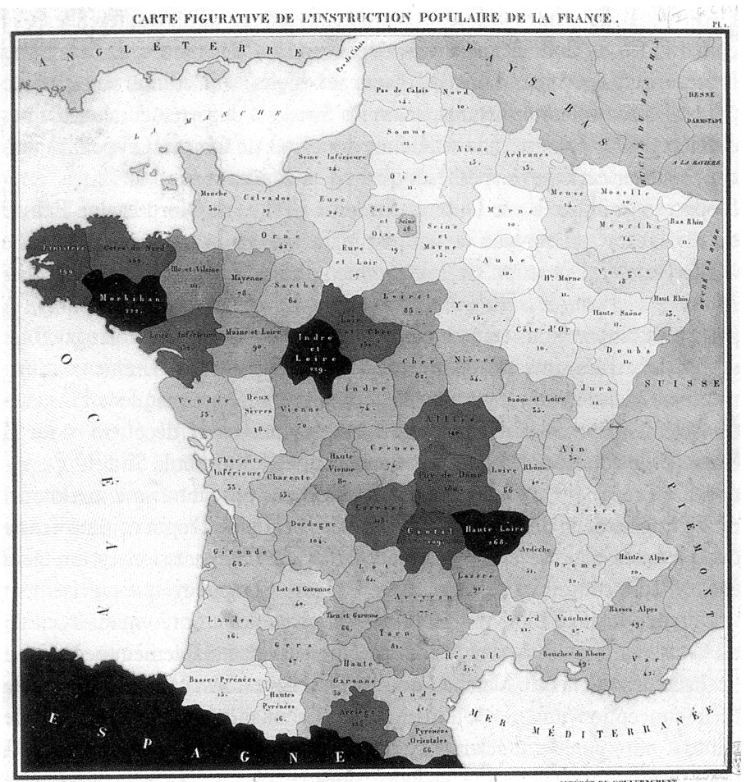
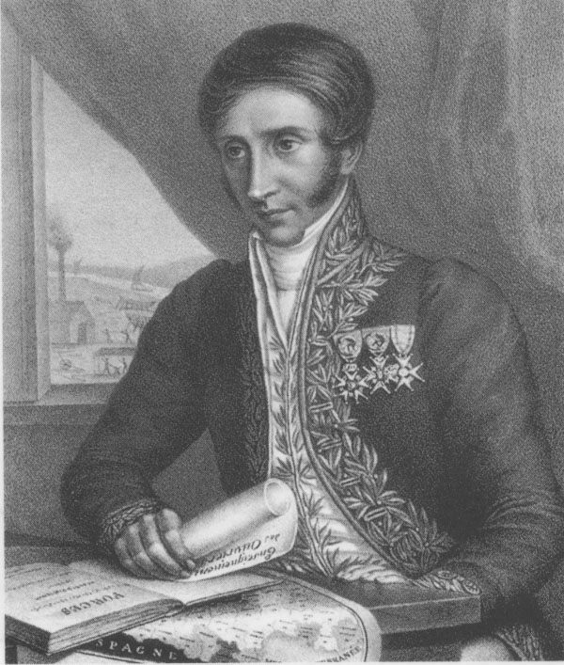
Social data
1826: The 1st choropleth map, showing the distribution of literacy in France – Baron Charles Dupin
Social variables became:
visual
subject to scientific discussion

Slide 9
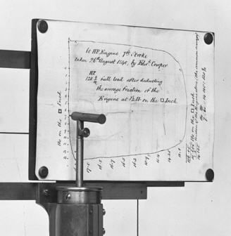
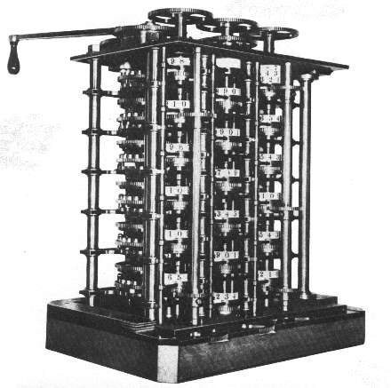
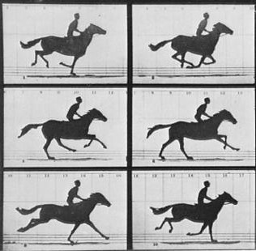
Preludes: technology
Copperplate → Lithography (1800+) → color printing (1850+)
Automatic recording: James Watt (1822)
Calculation: Babbage (1822/33), Guerry ~1850
Photography: Niépce (1827), Deguerre (1839), trichromatic process (1861)
Motion: Muybridge (1872), Marey (1882)
Notes:
Second, data-based graphics were always limited by the capabilities and economics of recording and reproduction.
A prime example is the transition from copperplate engraving to lithography in the early 1800s.
Robinson: At the time, the effect of lithography … was as great at the Xerox machine in our time.

Slide 10
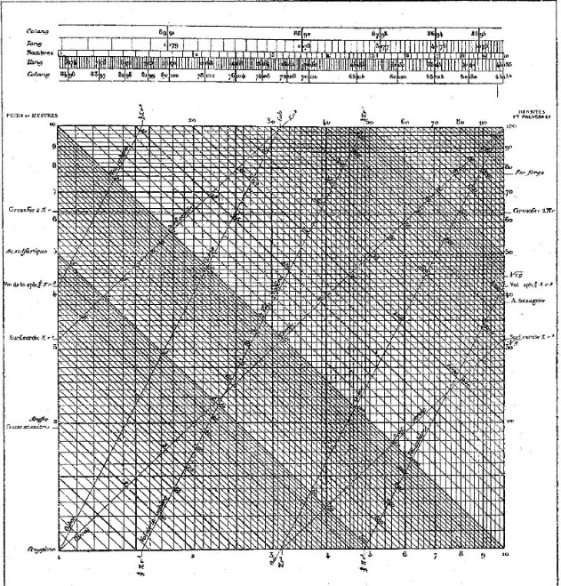
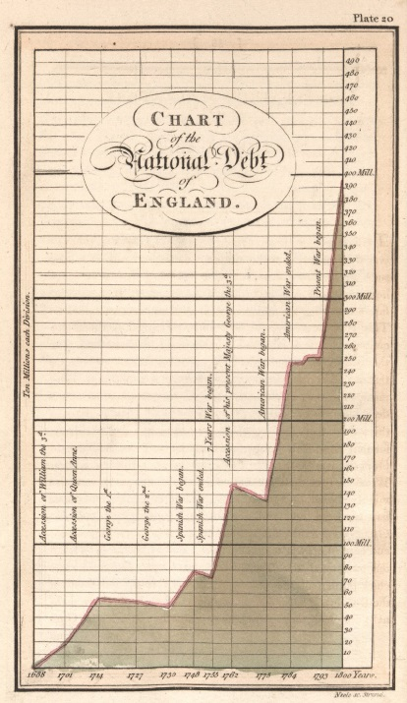
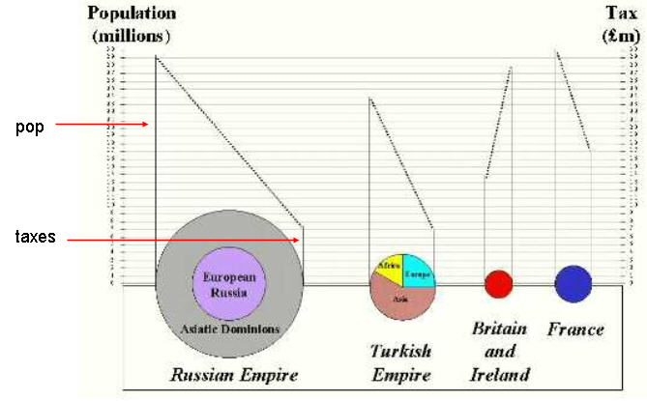
Preludes: visual language
Graphs & diagrams
Line, bar, pie charts– Playfair (1786, 1801)
Scatterplot– Herschel (1832)
Polar plots– Guerry (1829), Nightingale (1857)
Nomograms & graphical calculation– Lalanne (1846)
Notes:
In the first half of the 19th C, all of the modern forms of statistical graphics were invented. Each contributed new elements to an emerging visual language, designed to make the relations among numbers “speak to the eyes.”

Slide 11
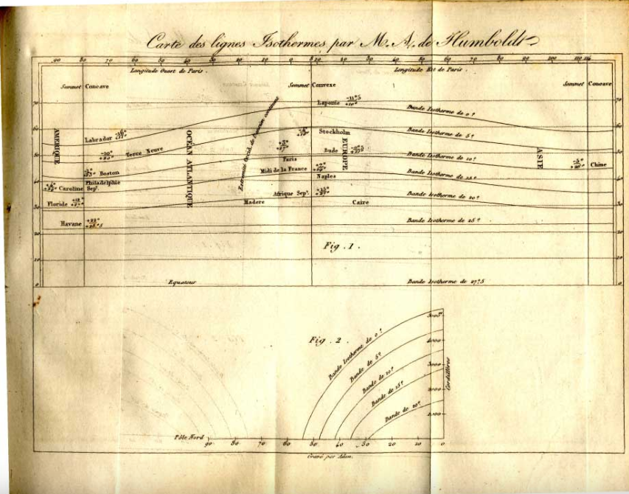

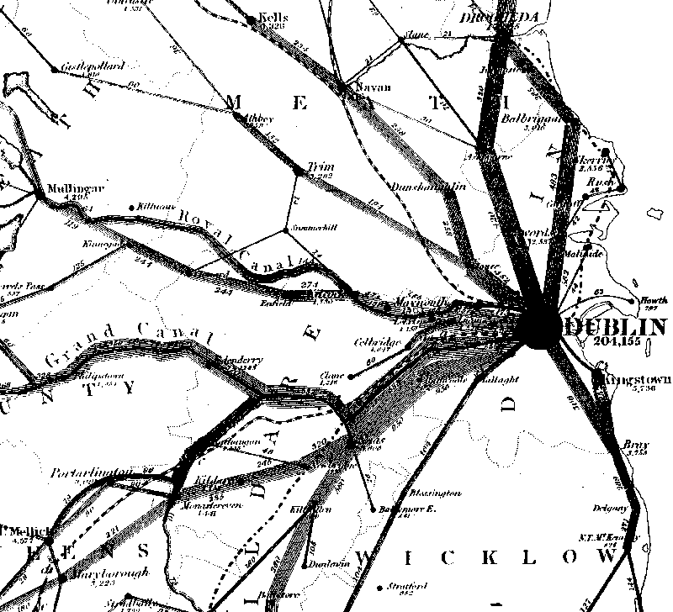
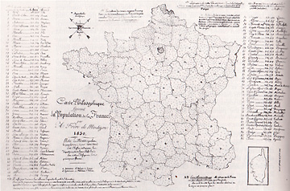
Preludes: visual language
Thematic maps
Isopleth– Humboldt (1817)
Choropleth– Dupin (1826)
Dot– Frère de Montizon (1830)
Flow– Harness (1837)
Notes:
Similarly, in thematic cartography, new visual forms were created or adapted to show quantitative information on maps
Isopleth: Halley → Humboldt to show isotherms
Choropleth: Dupin, literacy in France
Dot: Montizon, pop. density, 1 dot=10,000
Flow: Harness, railway traffic in Ireland
[omit]

Slide 12
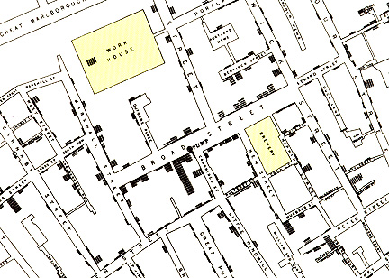
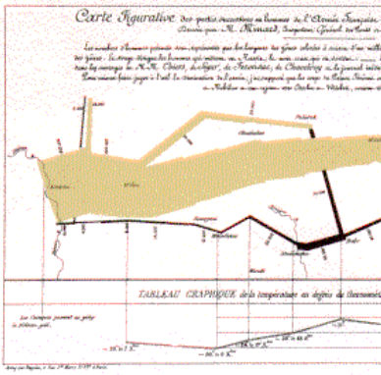
Visual language: thematic maps & statistical graphics
Different ‘visual language’, but common goals:
Exploration: show trends, reveal patterns in quantitative or qualitative info
Analysis: aid in synthesizing, generalizing or testing patterns
Presentation: stimulate thought, convey conclusions, argue a point
Snow (1855)
Galton (1863)
Minard (1869)
Notes:
Why it is useful to consider thematic maps and statistical graphics together?
The first point is that all data-based graphics– maps and diagrams share common goals, even though they may use different visual language

Slide 13

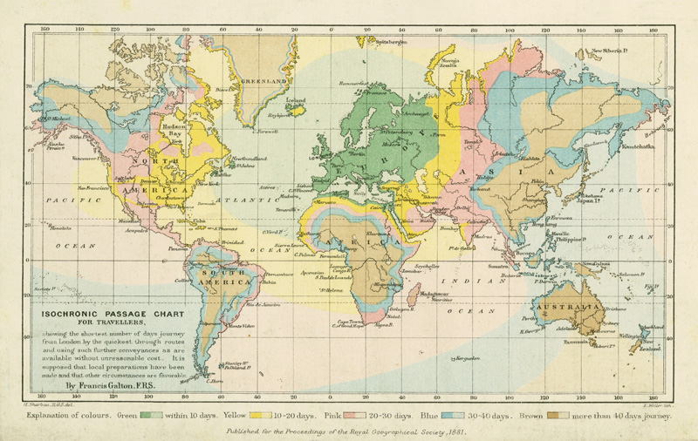
Data visualization: Diffusion of ideas
Those who developed thematic maps often not cartographers
Dupin (1826): literacy in France
Galton (1881): travel time from London
Notes:
A second, general point is that the histories of thematic cartography and statistical graphics have always been intertwined, with ideas and techniques from one side influencing the other.

Slide 14
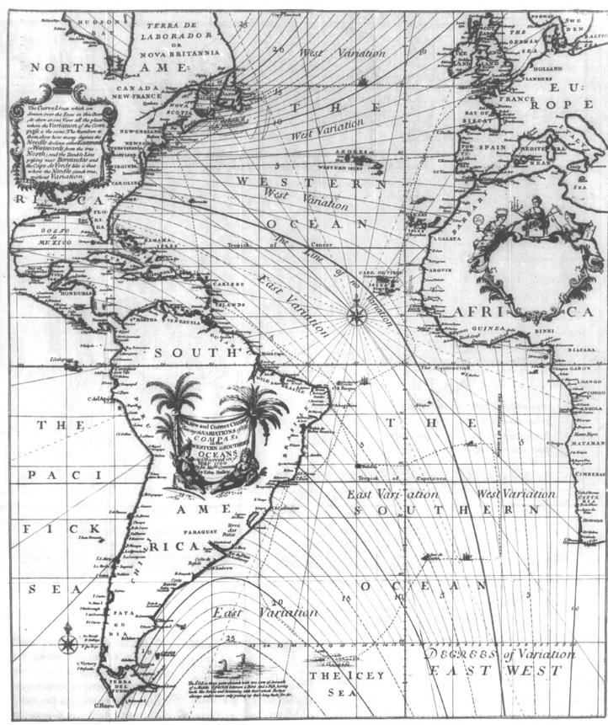
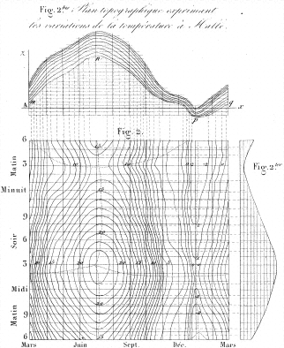
Data visualization: Diffusion of ideas
Those who developed data graphics often borrowed from cartography
Halley (1701): contour map -> Lalanne (1843): contour diagrams of soil temperature
Notes:
It was also frequently the case that men who developed data graphics often borrowed, and then extended, ideas from cartography

Slide 15
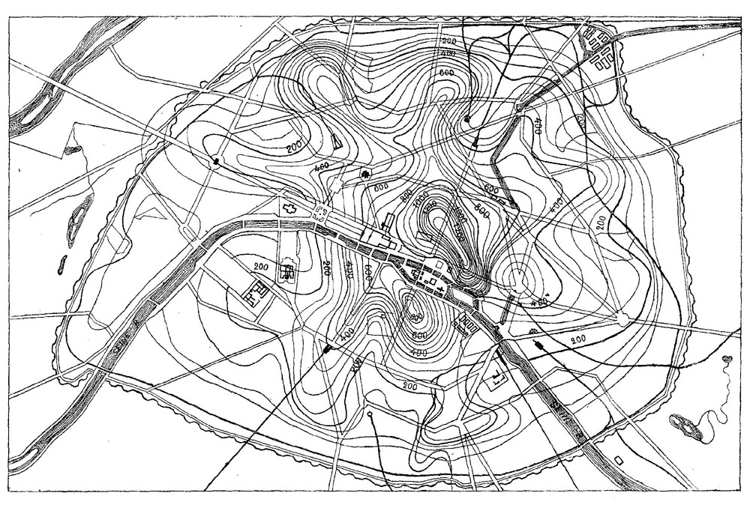
Data visualization: Diffusion of ideas
… and vice-versa
Lalanne → L.L. Vauthier (1874) contour map of population density of Paris, seen as mountains
Map-based data visualization was extended widely
Notes:
The general idea of using contours of equal value on a map was then extended to other domains
[omit]

Slide 16
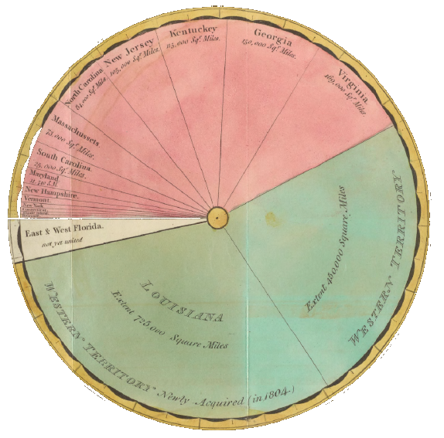
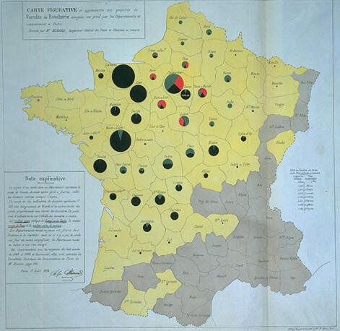
Data visualization: Diffusion of ideas
Graphical inventions often applied to maps
Playfair (1805): pie chart -> Minard (1858): pie map
What are the sizes of US territories?
Where does meat sold in Paris come from?
Notes:
Another point of intersection is that graphical inventions for statistical diagrams soon found uses in map-based displays and explanations.
Here, CJ Minard, whom I will return to later, uses Playfair’s invention of the pie chart in a new and extended way

Slide 17
Stories from the Golden Age (1850-1900)
Stories:
A.-M. Guerry & the rise of social science
Graphic vision of C. J. Minard
Galton’s graphical discoveries
Statistical albums
Themes:
Statistics: numbers of the state
Rise of visual thinking
Escaping flatland: 2D → 3D
Visualization → Theory (graphic discovery)
Data → Theory → Practice
Graphical excellence
Notes:
I’ll tell just a few brief stories, connected by the themes listed---

Slide 18
Big questions of the early 1800s
Issues for European states
Demography: taxes, raising an army (Süssmilch, 1741)
“Statistik”: Numbers of the state (Achenwall, 1748)
Social problems: crime, suicide, literacy, etc.
Disease epidemics, e.g., cholera
Anthropometry: the measure of Man
Distributions of human characteristics (Quetelet)
Mortality, suicide, propensity to crime
Beginnings of statistical theory and application
Normal dist^{n} (de Moivre, 1733)
L’homme moyen (Quetelet, 1835)
Notes:
My first vignette concerns the data and graphics that arose in the early 1800s. What were the big questions of that era?

Slide 19
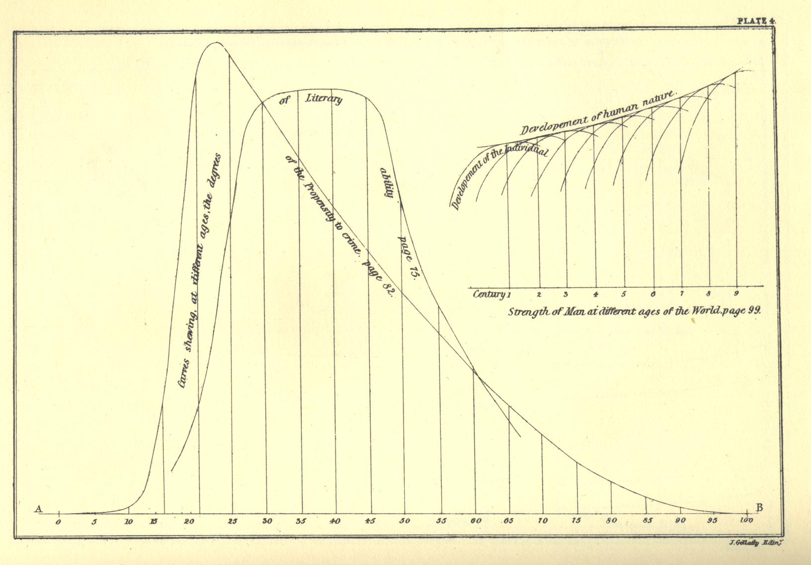
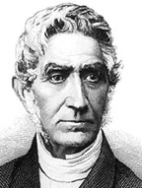
Quetelet: Anthropometry
Quetelet (1842), A Treatise on Man and the Development of His Faculties, uses graphs to illustrate various themes: measurement, graphical comparison, …
Literacy
Strength
Crime
Human characteristics could be measured and studied graphically
Propensity →
Age

Slide 20
Big data of the early 1800s: “An avalanche of social numbers”
J.-B.J. Fourier: Recherches statistique sur la ville de Paris (1821-1829)
Massive tabulations: births, deaths (by cause), admission to insane asylums (age, sex, affliction)
Ministry of Justice: Compte generale (1825--)
First national compilation of criminal justice data
All charges & dispositions, quarterly, 86 departments
Other sources:
Bureau de Longitudes (illegitimate births)
Parent-Duchatelet (prostitution); Min. of War (desertions)
Suicide notes in Paris collected and analyzed for motives
Social issues could now be addressed with DATA
Notes:
An important development was that there was now big data available – so much that Ian Hacking referred to this as “an avalanche of social numbers,” mostly referring to developments in France.

Slide 21
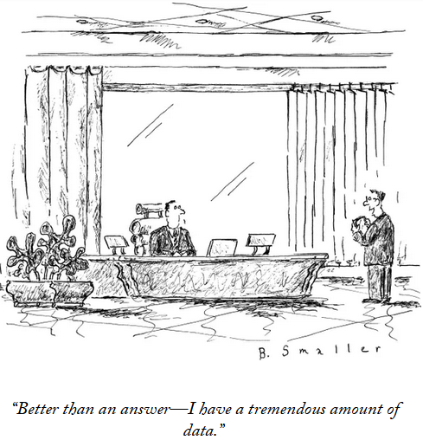
Image: The New Yorker, Jan, ??, 2024

Slide 22
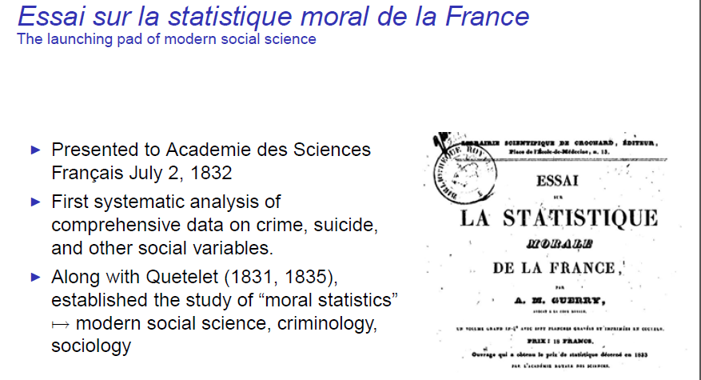
1. A. M. Guerry and the rise of social science
Notes:
So, here is my 1st vignette, relating the story of one of my heroes – Andre-Michel Guerry.

Slide 23
Social context of crime in 1820s France
Crime a serious concern:
Explosive growth in Paris after Napoleon’s defeat (Waterloo, 1815)
Widespread unemployment,
Emergence of perception of “dangerous classes”: what to do???
Victor Hugo (Les Misérables); Honoré de Balzac; Emile Zola
Liberal (“philanthrope”) view:
Increase education
Better prison conditions, diet (bread and soup)
Religious instruction
Conservative view:
Build more prisons; longer prison sentences
Harsher treatment of recidivists
Now, there was finally some DATA!
Notes:
In the time after the fall of Napoleon, there was widespread social upheaval in France, and crime became a serious concern.
Then, even as it is today, there were two opposing views …

Slide 24
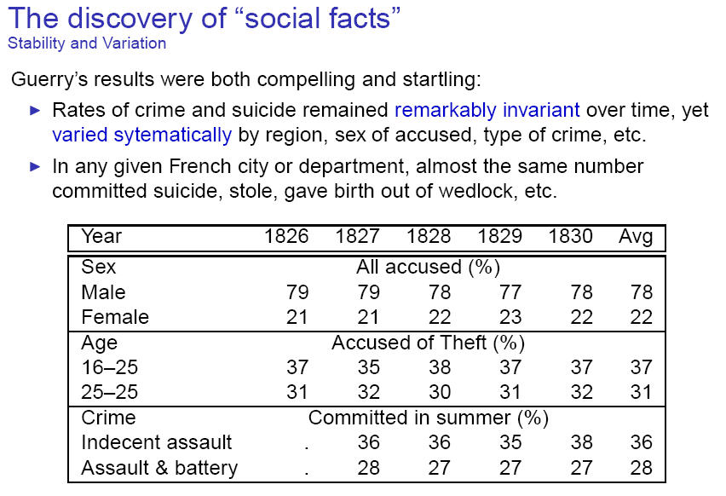
OMG! ~ constant
OMG! ~ constant
“We are forced to conclude that the facts of the moral order are subject, like those of the physical order to invariable laws.” (Guerry, 1833, p14)
Notes:
Guerry tabulated rates of crime over time and many other variables.
His results were both compelling and startling, because they showed both stability over time and variation …

Slide 25
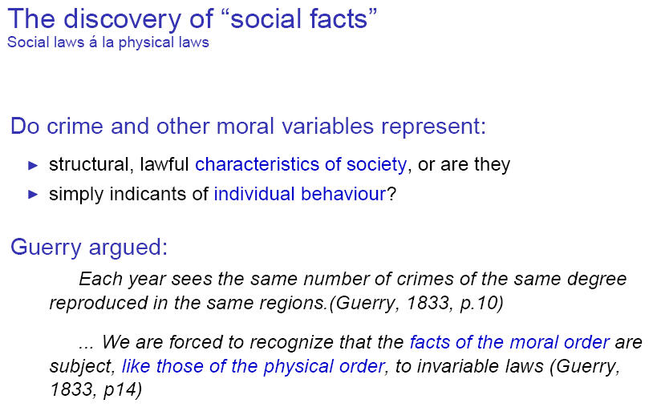

Slide 26
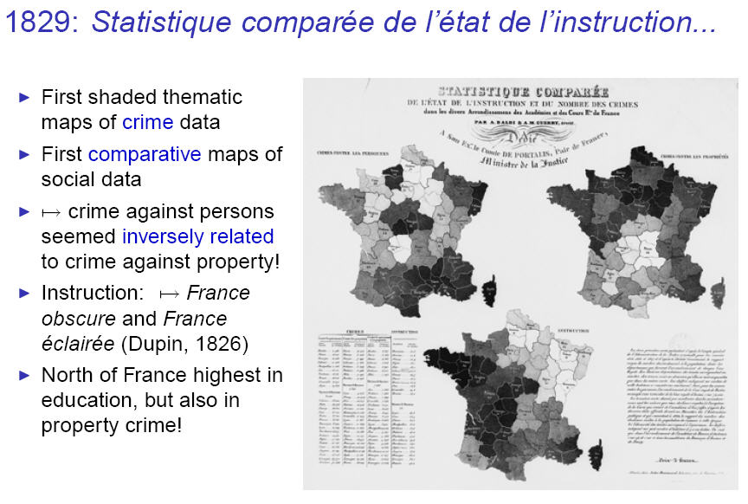
Personal crime
Property crime
Education
Notes:
The idea of using shading to show the value of a quantitative variable on a map had only recently been invented by Baron Charles Dupin.
Guerry wanted to explore whether crime was related to level of education in France, and had the idea to draw maps on the same sheet so they could be compared.

Slide 27
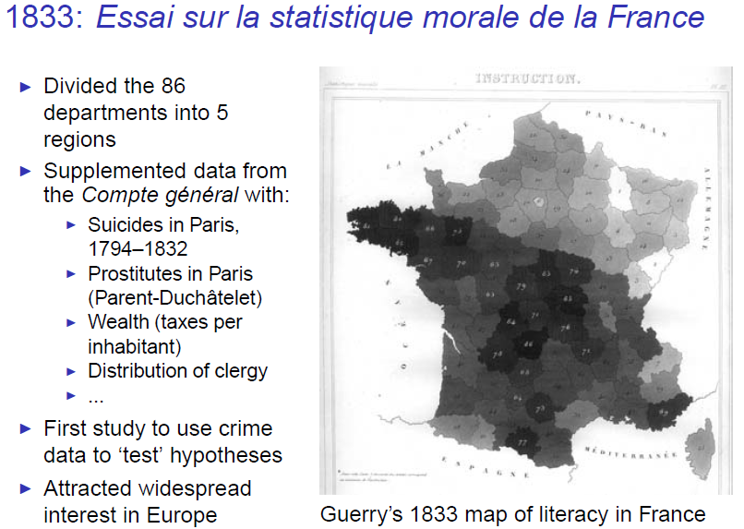

Slide 28
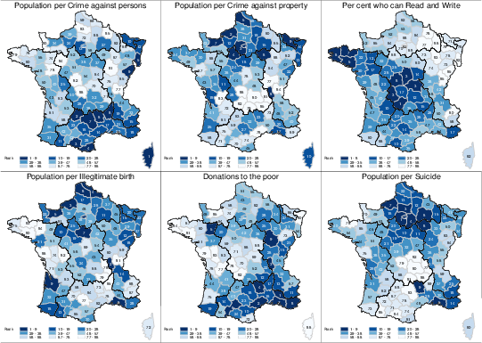
Guerry’s moral variables

Slide 29
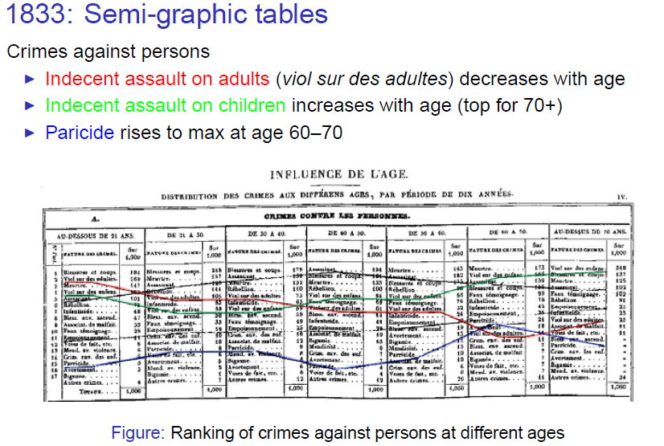
Notes:
How to show trends of many kinds of crime over age?

Slide 30
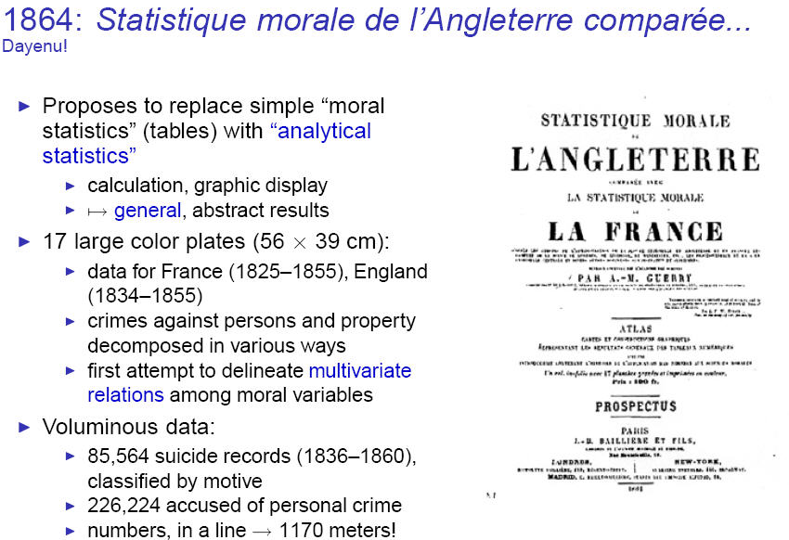
Further details: Friendly, M. (2007). A.-M. Guerry's Moral Statistics of France: Challenges for Multivariable Spatial Analysis, Statistical Science, 22, 368-399
Notes:
Guerry worked for another 30 years on the problem of understanding the determinants of crime in relation to other social factors.
His last work, published in 1864 was a comparative analysis of huge data from England and France collected over this time …

Slide 31
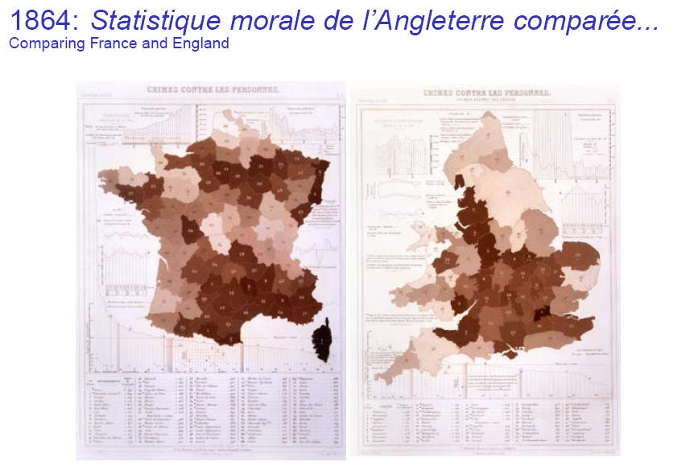
Crimes against persons
France
England
Graphs and tables around the outside give details: data, trends over time, or season, …

Slide 32
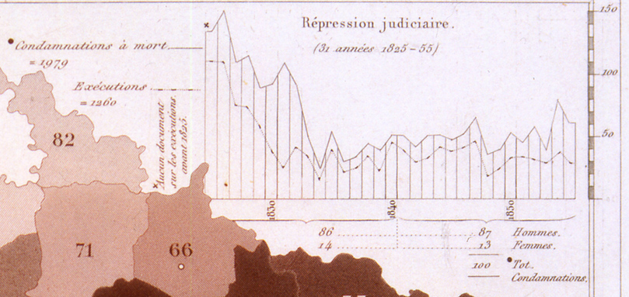
Detail: Trends in death sentences and executions over 31 years

Slide 33
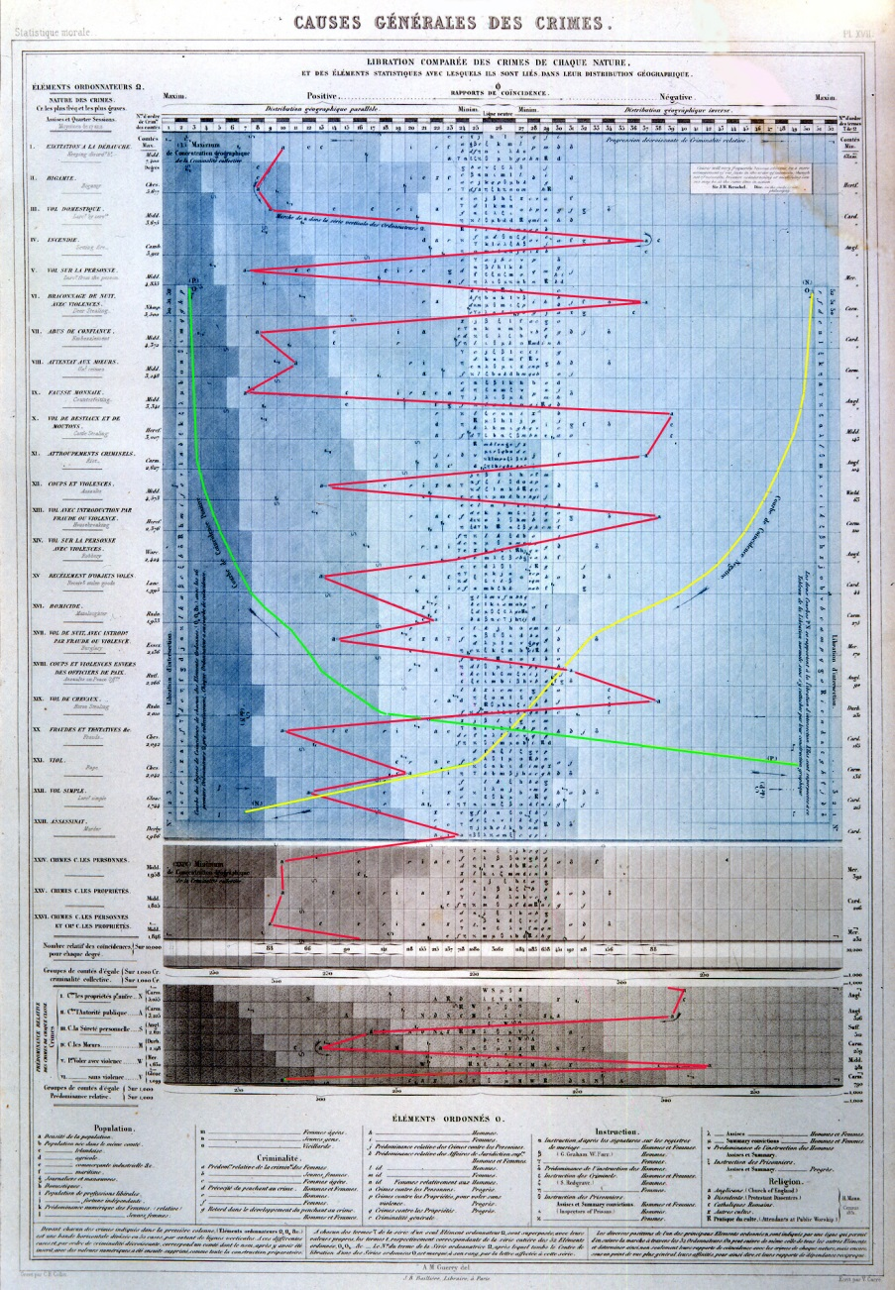
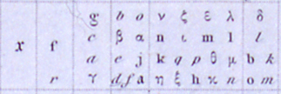
Statistique analytique: General causes of crime
Plate XVII: M. Guerry’s magnum opus
English counties (ranked on each)
Goal:
Show multivariate factors associated with distribution of crime
Before invention of correlation
max
min
bigamy
High pop. density
arson
Curve of neg. association
Crimes (ranked)
Entries: Codes for factors
Pop: (% Irish, domestics, …)
Criminality: (male, young, …)
Religion (Anglicans, dissenters, …)
Curve of pos. association
rape
murder

Slide 34
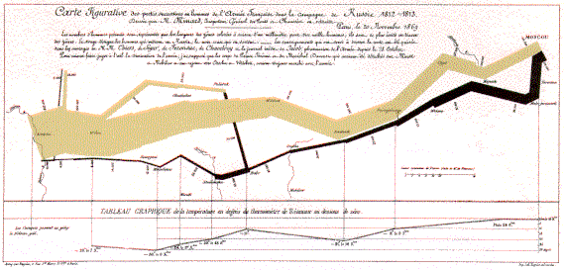
2. The graphic vision of C. J. Minard
Marey (1878): “defies the pen of the historian in its brutal eloquence”
Tufte (1983): “the best statistical graphic ever produced”
Notes:
My next vignette starts with the famous graph by Charles Joseph Minard depicting the fate of Napoleon’s Grand Armee in the disastrous 1812 campaign on Moscow.
Do I need to describe it?
It shows the strength of Napoleon’s army, starting nearly half a million strong at the Polish border …

Slide 35
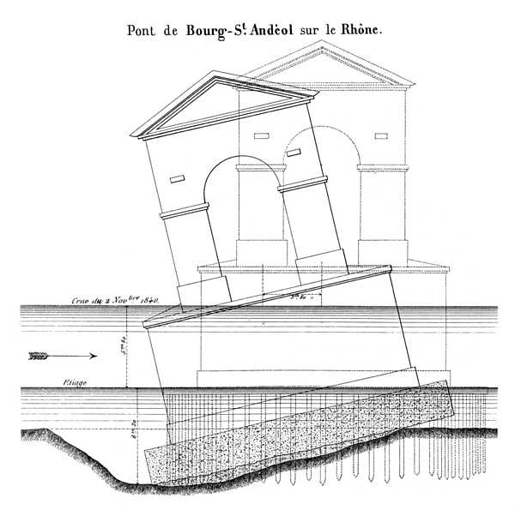
Visual thinking, visual explanation
Minard’s main career was a as a civil engineer for the ENPC (bridges & roads)
1840: Why did the bridge at Bourg-St. Andèol collapse?
Minard’s report consisted essentially of this self-explaining diagram.
Notes:
We see evidence of visual thinking even in his earliest work as a civil engineer.

Slide 36
Big questions of the mid 1800s
1830—1860: emergence of modern French state, dawn of globalization
Trade, commerce, transportation:
Where to build railroads, canals?
How to compete with imports/exports?
Visualizing changes over time, differences over space
→ Flow maps and other graphical innovations
These questions motivated the “Golden Age” of statistical graphics.
data, statistics, technology & visual thinking
See: Friendly, M. (2008). The Golden Age of Statistical Graphics, Statistical Science, 23, 502-535, https://www.datavis.ca/papers/golden-age.pdf
Notes:
Minard worked at a time that saw the emergence of the modern French state and the dawn of globalization.
The important questions for state planning concerned trade, commerce and transportation.

Slide 37
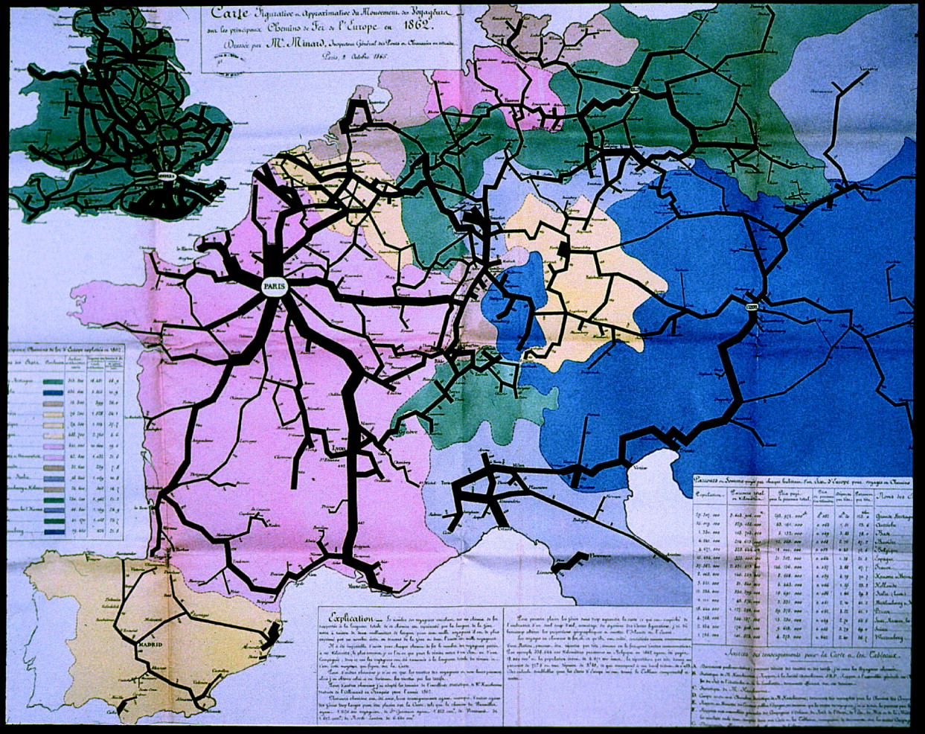
Flow maps as visual tools
Transport of passengers on the principal railroads in Europe in 1862
The dominant principle which characterizes my graphic tables and my figurative maps is to make immediately appreciable to the eye, as much as possible, the proportions of numeric results.
...Not only do my maps speak, but even more, they count, they calculate by the eye.
-- Minard (1862)
Notes:
Most of Minard’s graphics were designed to show the movement of goods and people. Flow maps were developed to a near art form

Slide 38
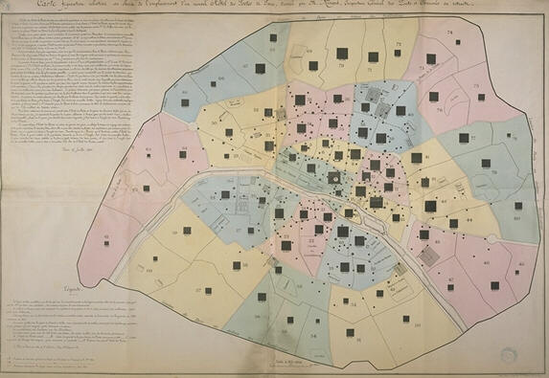
Q: Where to build a new post office in Paris?
Visual solution: at the center of gravity of population

Slide 39
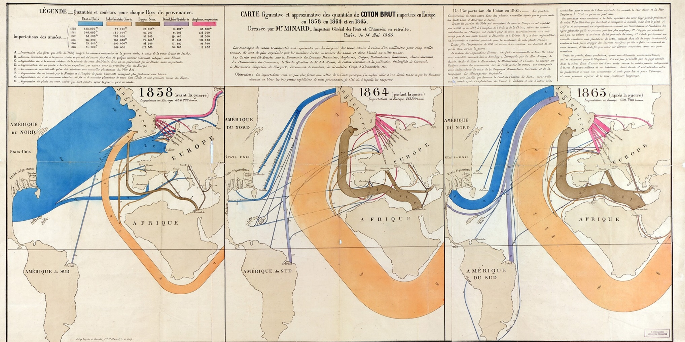
Visual explanation
What was the effect of the US Civil War on trade in cotton?
Before
During
After
“Carte figurative et approximative des quantités de coton brut importées en Europe en 1858, en 1864 et en 1865” by Charles Joseph Minard (1866)

Slide 40

The March Re-Visited (1869)
Hannibal’s retreat
Napoleon’s 1812 campaign
Notes:
The March on Moscow graphic was among the last of Minard’s works, and was part of a pair of flow maps, the other showing the course of Hannibal’s retreat across Spain, France, and the alps. Together, they are essentially an antiwar statement on the folly and human cost of the thirst for military glory.

Slide 41


Les Chevaliers: Minard’s Tomb
Jean-Pierre Airey-Jouglard Antoine de Falguerroles
Recent discovery of Minard’s tomb in Montparnasse Cemetery, Paris.
Celebrated June 5, 2017
MF Gilles Palsky

Slide 42


Slide 43

3. Galton’s discovery of weather patterns- Perhaps the most notable purely graphic discovery ever!
(Galton, 1863)
Notes:
Galton is most well-known for his discovery of regression toward the mean (1888) but he had achieved an even more notable graphic discovery 25 years earlier, in 1863.
It is not too far a stretch to claim this as the best example of a scientific discovery achieved almost entirely through graphical means– something that was totally unexpected, and purely the product of his use of remarkably novel high-dimensional graphs.

Slide 44

Method: All weather stations across Europe asked to record data 3x/day for all of Dec., 1861
Galton’s data collection form:
Notes:
In 1860, Galton set out a campaign to gather weather data from all weather stations, lighthouses and observatories across Europe, enlisting the aid of >300 observers.

Slide 45


Method: All weather stations across Europe asked to record data 3x/day for all of Dec., 1861
Data: recordings of barometric pressure, wind dir/speed, rain, temp., cloud: 3x/day, 50 weather stations in Europe.
Graphic analysis: 3x31=93 maps, each with multivariate glyphs showing all variables
Visual ideas:
Iconic symbols
Multivariate glyphs (stamps!)
Notes:
In 1860, Galton set out a campaign to gather weather data from all weather stations, lighthouses and observatories across Europe, enlisting the aid of >300 observers.

Slide 46


Visual abstraction → Patterns
How to see patterns of geographical variation over time?
Iconic symbols on a geographical grid
“Small multiples:” separate graphs laid out for direct comparison
Notes:
But, how could he see the relations of different weather variables and understand how they varied over space and changed over time?
An initial step was reduce the map of Europe to a grid, and show what was happening there by iconic symbols.
Making these small, and composing them side-by-side in small multiples allowed him to begin to see these patterns of variation in space and time.

Slide 47

Visual abstraction → Patterns
What varies with what, over time and space?
mini, abstract maps: vars x TOD
iso-contours, shading to show equivalence
arrows to show wind direction
pressure
wind, rain
temperature
AM
noon
PM
Data for Dec 5, 1861
Notes:
Galton’s insight came from 93 maps like UR: 3 for each of 31 days.
What is key here is his ability to compare the maps to see changes of wind direction with pressure over time

Slide 48

The large picture → Insight
AM
12
PM
Pattern:
Low pressure (black) in early Dec. → CCW wind
High pressure (red) in late Dec. → CW wind
pressure
wind, rain
temp.
Graphic: 3x3x31 grid, mapping {pressure, wind/ rain, temperature} x {AM, 12, PM} x day {1:31}
(try this with your software!)
Notes:
Putting these together…

Slide 49

Visual insight → Theory
Visual insight from 93 (3x31) high-D graphs:
Changes in wind dir w/ pressure over time
→ Winds revolve inwardly (CCW) in low pressure areas– as in a cyclone;
→ revolve outwardly (CW) in high pressure areas– “anti-cyclone”
Theory:
Explained by Dove’s ‘Law of Gyration’
Prediction: reversed pattern (CW/CCW) in southern hemisphere – confirmed!
Notes:
From this he saw that there were two different patterns in the relation of barometric pressure to wind direction

Slide 50

Theory → Practice
The first modern weather map, London Times, Apr. 1, 1875
Galton did for weathermen what Kepler did for Tycho Brahe. This is no small accomplishment. (Wainer 2005)
Notes:
Or, to paraphrase Bob Dylan, you do need a weatherman to know which way the wind is blowing.

Slide 51
4. Statistical atlases: Data → practice, national identity & graphical excellence
Collection of gov’t statistics on pop., trade, moral & political issues widespread in Europe & US, starting ~ 1820
Statistical albums ~ 1870—1910
France: Album de Statistique Graphique: 1879-1899
USA: Census atlases: 1870/80/90
Germany: local albums (Berlin, Frankfurt, etc.)
Switzerland: Atlas graphique de la Suisse:1897, 1914
Others: Latvia, Romania, Bulgaria, etc.
Notes:
My final theme from the Golden Age concerns the collection of statistical atlases and albums produced in Europe and the USA from roughly 1870 to 1910.
These served various purposes:
visualizing progress in commerce, industry & transportation
providing a companion volume in connection with national expositions
providing a graphic portrait of a nation
helping to create a national identity
The resulting publications were impressive, both for the wide range of graphic methods and the great skill of their visual design

Slide 52





Album de statistique graphique
Published by the Statistical Graphics Bureau, Ministry of Public Works, Émile Cheysson, director
18 volumes: 1879-1899, 12—34 plates each, ~ 11”x15” pages
Graphic forms:
Flow maps (simple, double, multi)
Pie maps, star, radial, polar time-series, proportional circles
Mosaic maps, anamorphic maps, planetary diagrams
Choropleth, bi-polar scales
Charts: line, bar, time-series
Pinnacle of the Golden Age: exquisite sampler of all known graphic forms!
Notes:
The most impressive collection of these is undoubtedly the Album de statistique graphique, published by the Statistical Graphics Bureau …

Slide 53



Album de statistique graphique
Spiral time-series on a map
Changes in the population of France from 1801—1881, by department [Album, 1881, plate 25]
Where is population growing most? least? declining?
Why use this graphic form?
Notes:
Demographic data were not often subjects of the Albums, but this image from the 1881 album is particularly attractive.
It shows the changes in population in the departments of France over an 80 year period by time-series plots in polar form.
For each department, the white circle shows the mean; years where pop < mean shaded red, years > mean shaded blue-green

Slide 54


Recursive multi-mosaic map
Distribution of passengers and goods from the Paris railways to the rest of France [Album, 1884, pl. 11]
(The image that launched my interest in the history of data vis.)
Notes:
This is my favorite image, from the 1884 Album

Slide 55


Anamorphic map
Shrinking France to show change in travel time over 200 years [Album, 1888, plate 8]
Notes:
Another ‘singular’ plate, from the 1888 Album, used great ingenuity to show visually how travel time in France had decreased over 200 years – by actually shrinking the map!

Slide 56

Album de statistique graphique
Q: How did Paris benefit from various int’l expos? How to show this visually?
Polar area diagrams on Paris map
Gross receipts in theaters in Paris, 1878—1889, related to universal expositions [Album, 1889, plate 26]
Totals, 1848-1889
Palais Royale
Odeon
Cluny
Notes:
The 1889 volume followed the universal exposition in Paris of that year, and several plates were devoted to analysis of data on that topic.
What effect did these have on attendance in theaters?
Here, they are shown as polar diagrams, area ~ gross receipts for the major theaters.
To aid interpretation, these figures are placed on a map of the right bank, with theaters off-scale shown in boxes.

Slide 57

Two-way table of star/radar diagrams
Attendance at the universal expositions in 1867, 1878, 1889 (rows), by month (cols) and days (rays). [Album, 1889, plate 21]
1867
1878
1889
Notes:
Another plate from the same volume uses what are now called star or radar diagrams to show attendance at each of the universal expos held in Paris: 1867, 1878 and 1889.
These are laid out as a two-way table of plots, in a form we now call a “trellis display,” designed to allow comparisons of the rows and columns.
We can see:
attendance increased greatly from 1867 to 1889
usually greatest on Sundays
in 1889, there were a number of additional spikes that are noted on the graphs

Slide 58

Planetary diagrams
Movement of principal merchandise by region. Spiral ~ distance; circles ~ tonnage [Album, 1895, plate 9]
Combustible minerals
Construction materials
Notes:
Many of the plates used novel graphic forms to show two or more related variables simultaneously on a schematic map of France.

Slide 59

Classed choropleth maps,
bipolar color scale
visualizing change
Circulation on the national roads in ‘colliers réduits’, a standard measure
Left: 1894; Right: % change, 88-94
[Album, 1895, plate 21]
Notes:
Along with new graphic forms, there also had to be new ways to measure and count, and ways to show changes over time.
These maps show transportation on the national roads in France, calculated in “colliers reduits” – a standard measure of transport based on the equivalent number of animals for each conveyance. (It’s not clear how they counted bicycles!)

Slide 60


2x2 graphic bar charts
4 variables shown
creative folding of long bars
Expenses of the first establishment of railroads of the world as of 1883
[Album 1886, p. 11]
USA
total exp
exp per km
Canada

Slide 61

ASG now online: David Rumsey
All 18 volumes, https://www.davidrumsey.com/luna/servlet/s/nl72bu

Slide 62
U.S. Census Atlases
Statistical Atlas of the Ninth Census (1872) – Francis Walker
60 plates: First graphic portrait of the nation
Topics: geology, minerals, weather, pop. by ethnicity, wealth, literacy, death rates by age, sex, cause, rates of blindness, insanity, etc.
Tenth Census (1880) – Henry Gannett
151 plates
Eleventh Census (1890) – Henry Gannett
126 plates
Notes:
I turn finally to the statistical atlases prepared in conjunction with the US censuses from 1870—1890.

Slide 63


Mosaics/treemaps: Area ~ state population
State populations: Foreign born / Native colored / White + Born inside/outside [Atlas, 1870, plate 20]
Total: In/out
foreign
colored
white
GA
VA
inside
MO
outside
OH
PA
NY

Slide 64


Bilateral histograms: deaths (sex by month) ~ state, cause, nationality
state
[Atlas, 1870, plate 44]
cause
nationality

Slide 65


Catholics
Comparative density maps
Proportions of Catholics and Methodists in the total population [Atlas, 1890, plate 36]
What area(s) showed a surprising prevalence of Catholics in 1890?
Where was the population predominantly Methodist?
Detail (Catholics)
Methodists

Slide 66

Linked parallel-coordinates time-series diagram
Rank of states & territories in each census, 1790—1890. [Atlas, 1898, plate 2]
Q: What graphical features make this display more easily understood?

Slide 67



Golden Lessons
What are the lessons for the future?
Phenomena, not numbers or simply pretty pictures
Playfair, Guerry, Minard, Galton, etc. all developed new graphic forms to show phenomena of deep interest:
balance of trade, rates of crime, patterns in weather data, …
1st lesson: data visualization today should have a similar focus

Slide 68
Golden Lessons: Graphical Impact
Impact: Early ideas
Playfair, Guerry: data should “speak to the eyes”
Minard, Lalanne: allow “calculation by the eyes”
Nightingale: graphs should speak to the heart and mind, influence public policy & practice
Graphical impact (Tukey, 1990)
Interocularity: the message hits you between the eyes
Immediacy: it hits you fast
Inescapability: it is hard to avoid the message
2nd lesson: strive for visual impact in graphs and tables

Slide 69



Golden Lessons: Expressive power
Hand-made graphics were often beautiful but entailed much sweat and hard work.
Today: software– ease of use vs. expressive power
Theories of graphics → graphic “languages”
Bertin: Semiology of graphics
Wilkinson: Grammar of Graphics
Wickham: ggplot2 R package
In all: the devil is in the details!
3rd lesson: continue to reduce the distance between a graphic idea and appearance on screen or paper.
minimize

Slide 70
Conclusions
The only new thing… is the history you don’t know – Harry Truman
Data visualization has deep roots:
Cartography
Statistical theory
Data collection
Visual thinking
Technology
The Golden Age:
Qualitatively distinct, deserves recognition
Works of unparalleled beauty & scope
Statistical graphics had a purpose: tell a story, inform decision
Provides lessons for today and tomorrow
All combine to give insightful views of data
Each area fed from, and nourished the others
Notes:
In conclusion, my study of the history of data visualization has taught me several things, but among these---

